Slide 1
Relational Query Languages

Slide 2
What is an “Algebra”
Mathematical system
  Operands --- variables or values from which new values can be constructed
  Operators --- symbols denoting procedures that construct new values from given values

Slide 3
What is Relational Algebra?
An algebra whose operands are relations or variables that represent relations
Operators are designed to do the most common things that we need to do with relations in a database
  The result is an algebra that can be used as a query language for relations

Slide 4
Relational Query Languages (1)
A major strength of the relational model: supports simple, powerful querying of data
Queries can be written intuitively, and the DBMS is responsible for efficient evaluation
  precise semantics for relational queries
  Allows the optimizer to extensively re-order operations, and still ensure that the answer does not change.

Slide 5
Relational Query Languages (2)
Query languages: Allow manipulation and retrieval of data from a database
Relational model supports simple, powerful QLs:
  Strong formal foundation based on logic
  Allows for optimization
Query Languages != programming languages!
  QLs not intended to be used for complex calculations
  QLs support easy, efficient access to large data sets

Slide 6
Formal Relational Query Languages
Two mathematical Query Languages form the basis for “real” languages (e.g. SQL), and for implementation:
  Relational Algebra: More operational, very useful for representing execution plans.
  Relational Calculus: Lets users describe what they want, rather than how to compute it. (Non-operational, declarative.)

Slide 7
The SQL Query Language (1)
Developed by IBM’s System-R Project in the 1970s
Need for a standard since it is used by many vendors
Standards:
  SQL-86
  SQL-89 (minor revision)
  SQL-92 (major revision)
  SQL-99 (major extensions, current standard)

Slide 8
The SQL Query Language (2)
SQL has been influenced by both Relational Algebra (RA) & Relational Calculus (RC)
The other variant of RC is Domain Relational Calculus (DRC) which has greatly influenced Query By Example (QBE)

Slide 9
The SQL Query Language (3)
SQL consists of:
  DDL (Data Definition Language)
    Create conceptual schema
  DML (Data Manipulation Language)
    Relational operators
    Insert, Delete, Update
  VDL (View Definition Language)
    Specify user views & their mapping to the conceptual schema (in most DBMSs, done by DDL)
  SDL (Storage Definition Language)
    File organization
    Indexes

Slide 10
Operations on Relations
Restrict/Select
Project
Join
Divide
Union
Intersection
Difference
Product
Relational Operations
Set Operations

Slide 11
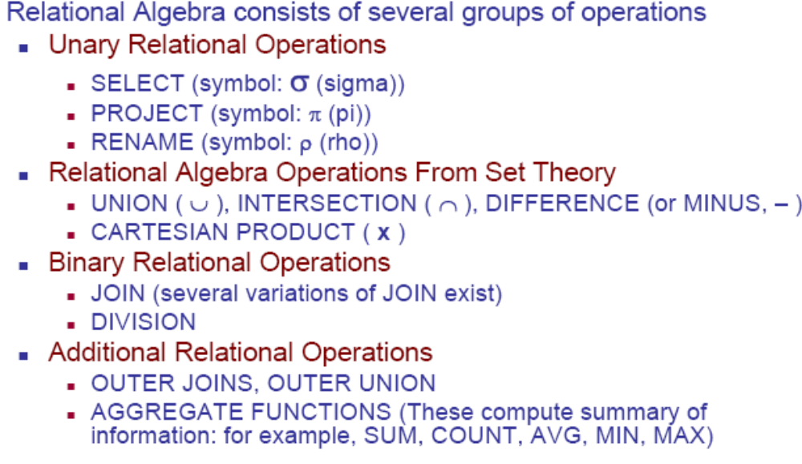
Relational Algebra Overview (Elmasri & Navathe)

Slide 12
Relational Algebra
Collection of operations on relations
8 operators + Rename operator
Codd’s 8 operators do not form a minimal set
Some of them are not primitive
Join, Intersect, & Divide can be defined in terms of other 5
None of these 5 can be defined in terms of the remaining 4
MINIMAL SET
Join, Intersect, & Divide are important & should be supported directly

Slide 13
Relational Algebra
Some common DB requests can not be performed with the RA operations
Additional operations are developed
Aggregate functions & additional types of joins

Slide 14
Relational Algebra
Provides a formal foundation for relational model operations
Plays a pivotal role in query optimization in RDBMSs
Some of its concepts are implemented in SQL
Expressive power of RA is used as a metric of how powerful a relational DB query language is

Slide 15
Relational Completeness
A relational DB query language is said to be Relationally Complete, if it can express all queries that we can express in RA
Relational DB query languages are expected to be relationally complete
Commercial query languages like SQL, support features that allow us to express some queries that are not possible in RA

Slide 16
Restrict & Project

Slide 17
Union, Intersection & Difference(1)

Slide 18
Union, Intersection & Difference(2)
Union Compatibility: r U s is valid if:
  Relations r & s have the same arity
  Domains of the i^{th} attribute of r is the same as the domain of the i^{th} attribute of s, ⍱ i.
  Note that r & s can be either database relations or derived relations

Slide 19
Product & Divide
A
B
C
X
Y
A
A
B
B
C
C
X
Y
X
Y
X
Y
A
A
A
B
C
X
Y
Z
X
Y
X
Z
DIVIDE BY
A
PRODUCT

Slide 20
Divide
DIVIDE
S1
S2
S3
S4
S1
S1
S2
S2
S2
S2
S3
S4
S4
P1
P2
P3
P4
P1
P2
P2
P2
P4
P2
P2
P4
S2
S4
P1
P2
P4
S2
Shipment
Parts

Slide 21
Join
A1
A2
A3
B1
B1
B2
B1
B2
B3
C1
C2
C3
A1
A2
A3
B1
B1
B2
C1
C1
C2
NATURAL JOIN

Slide 22
Closure
A relation is closed under relational and set operators
The result of these operators on relation(s) is another relation
Output from one operation can become input to another
Nested Expressions possible

Slide 23
Case Study: Sailors Database
Sailors (sid:integer, sname:string,rating:integer,age:real)
Boats ( bid:integer,bname:string,color:string)
Reserves (sid:integer, bid:integer,day:date)

Slide 24
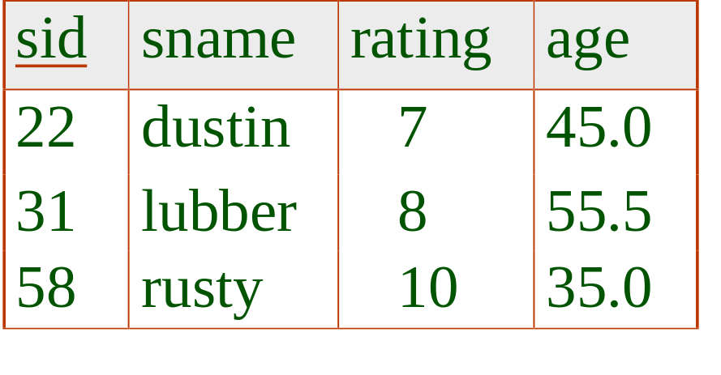
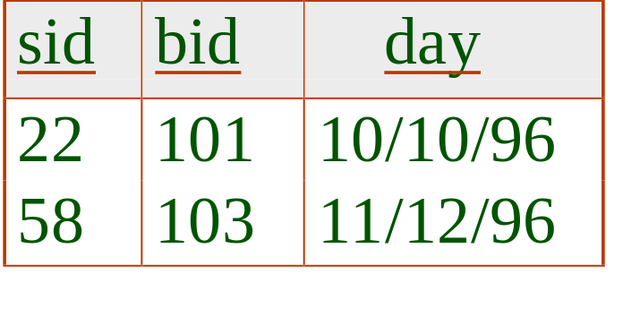
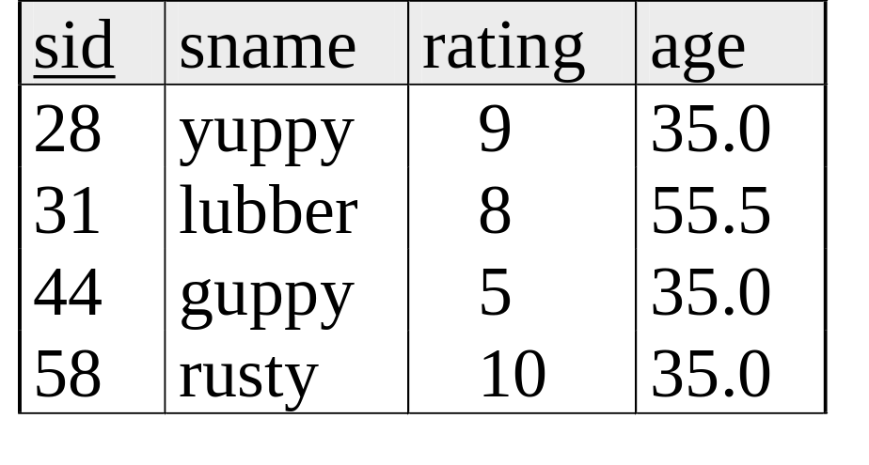
Example Schema
R1
S1
S2

Slide 25
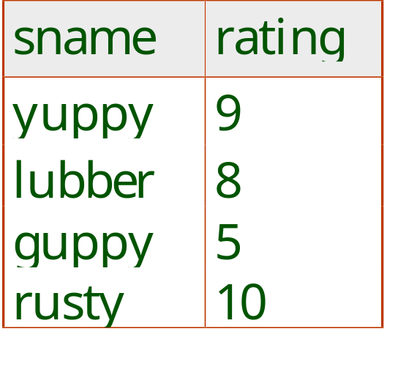
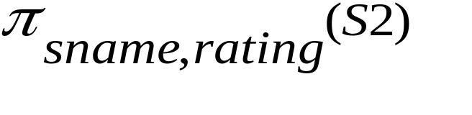
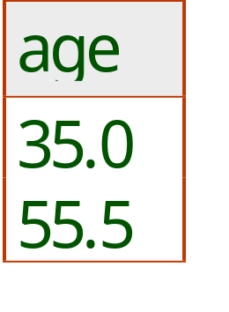
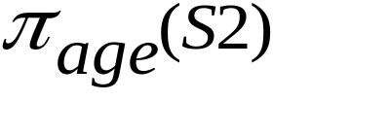
Projection
Deletes attributes that are not in projection list.
Schema of result contains exactly the fields in the projection list, with the same names that they had in the (only) input relation.
Projection operator has to eliminate duplicates! (Why??)
  Note: real systems typically don’t do duplicate elimination unless the user explicitly asks for it.
Notes:
7

Slide 26
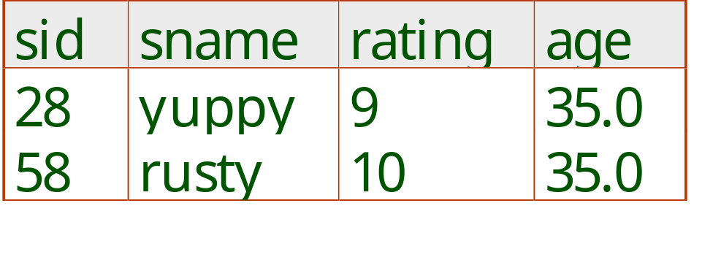
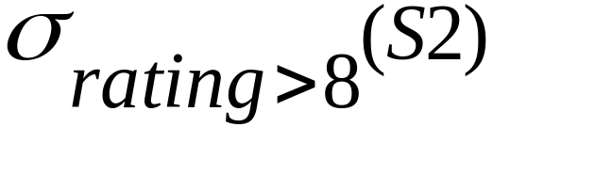
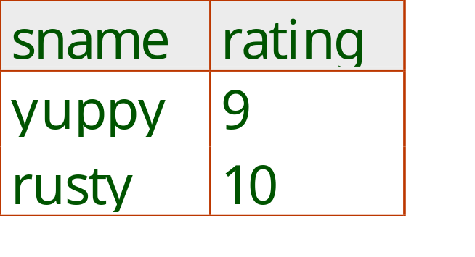
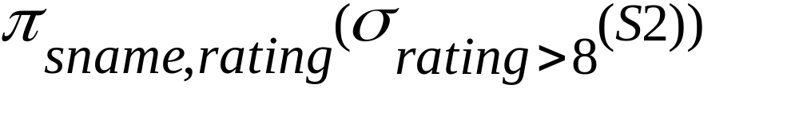
Selection
Selects rows that satisfy selection condition.
No duplicates in result!
Schema of result identical to schema of (only) input relation.
Result relation can be the input for another relational algebra operation! (Operator composition.)
Notes:
8

Slide 27
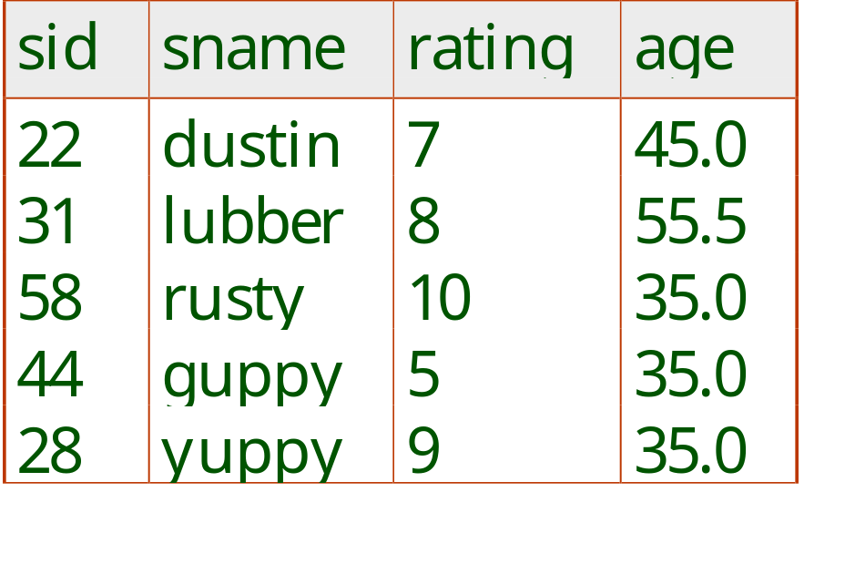
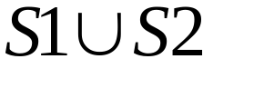
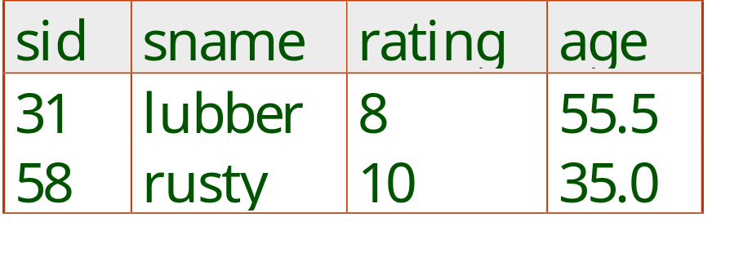
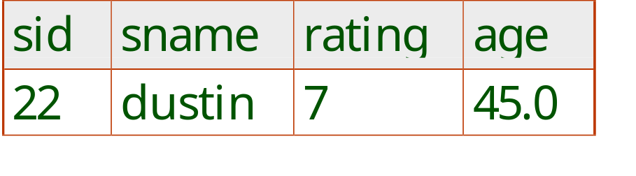

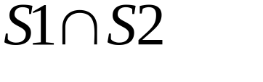
Union, Intersection, Set-Difference
All of these operations take two input relations, which must be union-compatible:
  Same number of fields
  `Corresponding’ fields have the same domain/data type
Notes:
9

Slide 28
Union, Intersection & Difference
Union Compatibility: r U s is valid if:
  Relations r & s have the same arity
  Domains of the i^{th} attribute of r is the same as the domain of the i^{th} attribute of s, ⍱ i.
  Note that r & s can be either database relations or derived relations

Slide 29
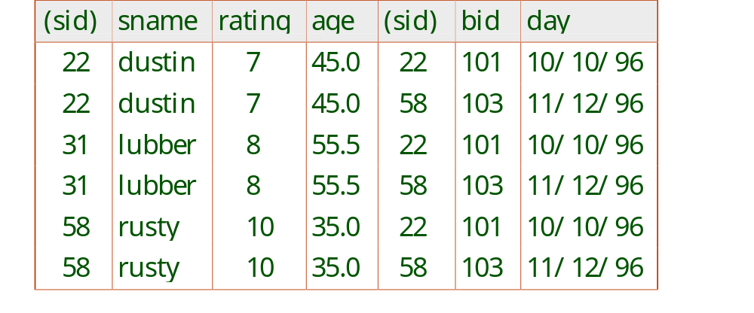
Cross-Product
Each row of S1 is paired with each row of R1.
Result schema has one field per field of S1 and R1, with field names `inherited’ if possible.
  Conflict: Both S1 and R1 have a field called sid.
Renaming operator:
Notes:
10

Slide 30
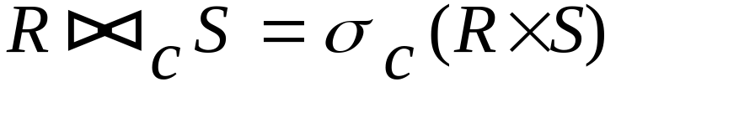
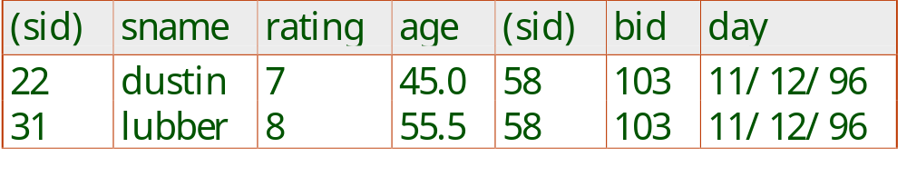
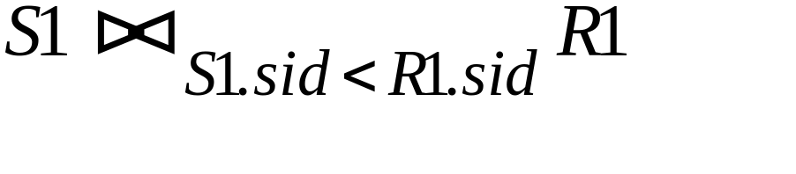
Joins
Condition Join:
Result schema same as that of cross-product.
Fewer tuples than cross-product, might be able to compute more efficiently
Sometimes called a theta-join.
Notes:
11

Slide 31
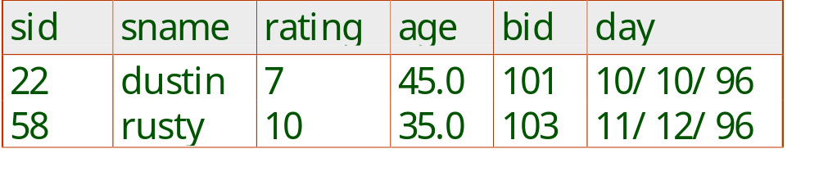
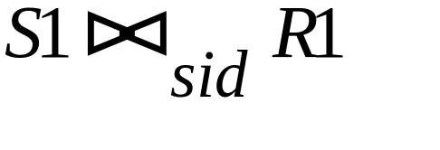
Joins
Equi-Join: A special case of condition join where the condition c contains only equalities
Result schema similar to cross-product, but only one copy of fields for which equality is specified.
Natural Join: Equijoin on all common fields.
Notes:
12

Slide 32
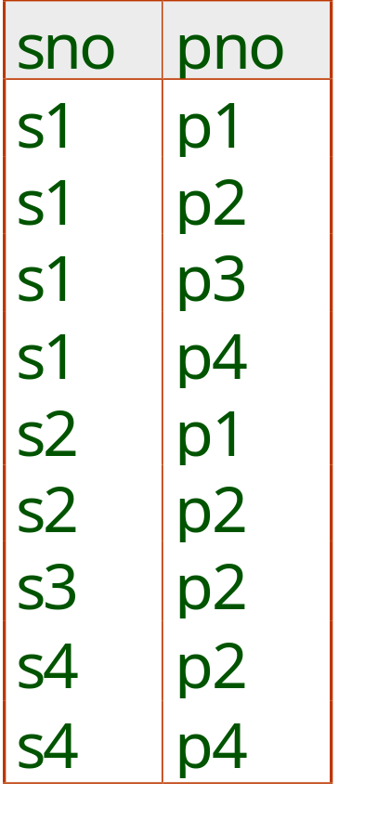
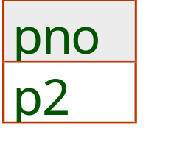
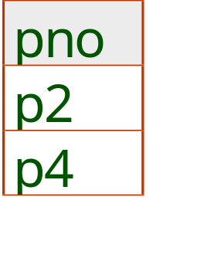
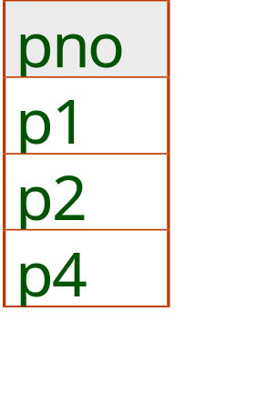
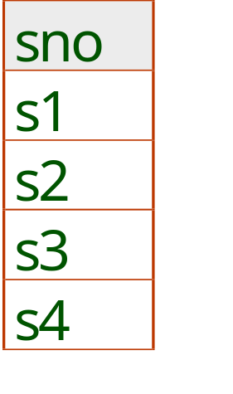
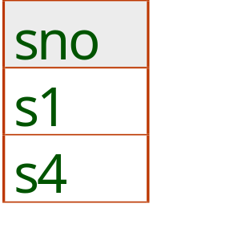
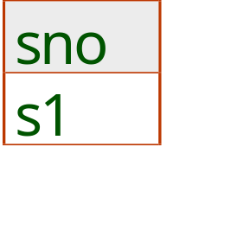
Examples of Division A/B
B1
B2
B3
A
A/B1
A/B2
A/B3
Notes:
14

Slide 33
Extended Operators of RA
Duplicate-Elimination Operator δ
Aggregation Operators
    Sum
    Count
    Average
    Max
    Min
Grouping Operator
Sorting Operator τ
Extended Projection
Outerjoin Operator

Slide 34
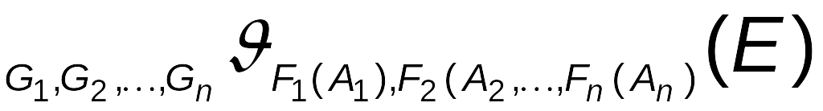
Aggregate Functions & Operations
Aggregation function takes a collection of values and returns a single value as a result.
avg: average value
min: minimum value
max: maximum value
sum: sum of values
count: number of values
Aggregate operation in relational algebra: General Form
E is any relation
  G₁, G₂ …, G_{n} is a list of attributes on which to group (optional)
  Each F_{i} is an aggregate function
  Each A_{i} is an attribute name

Slide 35
Aggregate Operation – Example
Relation r:
A
B
C
α
α
β
β
α
β
β
β
7
7
3
10
g _{sum(c)} (r)
sum(C )
27

Slide 36
Aggregate Operation – Example
Relation account grouped by branch-name:
branch_name
account_number
balance
Perryridge
Perryridge
Brighton
Brighton
Redwood
A-102
A-201
A-217
A-215
A-222
400
900
750
750
700
_{branch_name} g _{sum(balance)} (account)
branch_name
sum(balance)
Perryridge
Brighton
Redwood
1300
1500
700

Slide 37
Aggregate Functions (Cont.)
Result of aggregation does not have a name
  Can use rename operation to give it a name
  For convenience, we permit renaming as part of aggregate operation
_{branch_name} g _{sum(balance) as sum_balance} (account)

Slide 38
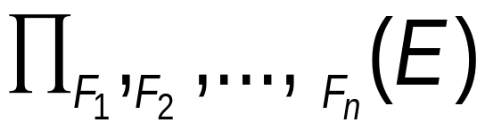
Generalized Projection
Extends the projection operation by allowing arithmetic functions to be used in the projection list.
E is any relational-algebra expression
Each of F₁, F₂, …, F_{n} are are arithmetic expressions involving constants and attributes in the schema of E.
Given relation credit_info(customer_name, limit, credit_balance), find how much more each person can spend:
∏customer_name, limit – credit_balance (credit_info)

Slide 39
Generalized Projection
Cust_name
limit
Credit_bal
Curry
Hayes
Jones
Smith
2000
1500
6000
2000
1750
1500
700
400
Given relation credit_info(customer_name, limit, credit_balance), find how much more each person can spend:
∏customer_name, (limit – credit_balance) as credit_available (credit_info)
Cust_name
Credit_available
Curry
Hayes
Jones
Smith
250
0
5300
1600

Slide 40
Outer Join
An extension of the join operation that avoids loss of information.
Computes the join and then adds tuples form one relation that does not match tuples in the other relation to the result of the join.
Uses null values:
  null signifies that the value is unknown or does not exist

Slide 41
Outer Join – Example
Relation loan
loan_number
branch_name
amount
L-170
L-230
L-260
Downtown
Redwood
Perryridge
3000
4000
1700
Relation borrower
customer_name
loan_number
Jones
Smith
Hayes
L-170
L-230
L-155

Slide 42
Outer Join – Example
Inner Join
loan Borrower
loan_number
branch_name
amount
customer_name
L-170
L-230
Downtown
Redwood
3000
4000
Jones
Smith
Left Outer Join
loan Borrower
loan_number
branch_name
amount
customer_name
L-170
L-230
L-260
Downtown
Redwood
Perryridge
3000
4000
1700
Jones
Smith
null

Slide 43
Outer Join – Example
Right Outer Join
loan borrower
loan_number
branch_name
amount
customer_name
L-170
L-230
L-155
Downtown
Redwood
null
3000
4000
null
Jones
Smith
Hayes
Full Outer Join
loan borrower
loan_number
branch_name
amount
customer_name
L-170
L-230
L-260
L-155
Downtown
Redwood
Perryridge
null
3000
4000
1700
null
Jones
Smith
null
Hayes

Slide 44
Null Values
It is possible for tuples to have a null value, denoted by null, for some of their attributes
null signifies an unknown value or that a value does not exist or something that is NA
Aggregate functions simply ignore null values (as in SQL)
For duplicate elimination and grouping, null is treated like any other value, and two nulls are assumed to be the same (as in SQL)

